Slide 1
Becoming Your Strategic Banking Partner
Dynamic
<Client Name>
<Client Logo>
<Date of pitch deck creation>
Notes:
Template Design guidelines - PPT Template - Downloadable File 20231207.pptx (sharepoint.com)

Slide 2

Contents
Predefined
Introduction to LBG Group
LBG Banking Group, Helping Britain Prosper, Executive Summary
2
Your Team
6
Your Local Team at LBG
Understanding Your Industry
8
Industry Overview, Industry Drivers, Industry Competitive Forces
Understanding Your Business
12
Company Overview, P&L Overview
How LBG can Support
13
How LBG can support
ESG Financing
17
ESG Financing Market, LBG recent Transactions, LBG ESG Solutions
LBG Products
21
Commercial Banking Online, CBO Future development, Embedded Payments Insurance
Notes:
Template Design guidelines - PPT Template - Downloadable File 20231207.pptx (sharepoint.com)

Slide 3
Introduction to LBG Group
Predefined

Slide 4
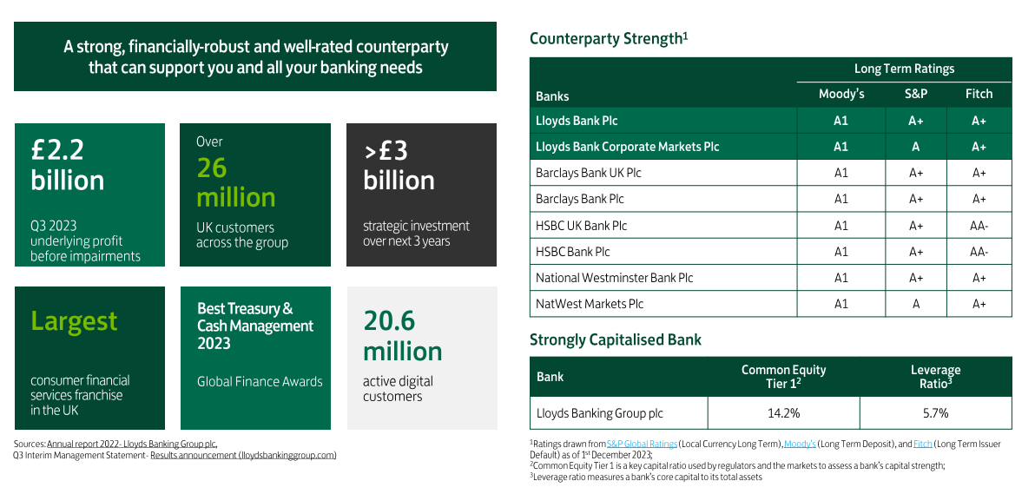
Introduction to Lloyds Banking Group
Predefined
Notes:
Source of slide - Corporate Coverage - 4c. 512023 LBG 20231201.pdf - All Documents (sharepoint.com)

Slide 5







Helping Britain Prosper
Predefined
Over 30 Million
UK Current Account Holders
Lloyds Bank has a commitment to ‘Helping Britain Prosper’ and continues to support the manufacturing sector with professional expertise delivered by our highly experienced relationship teams
Businesses
Sustainability
£3bn
of capital in 2020 invested in future growth supporting the UK manufacturing sector
290+
Lloyds clients have been supported through partnership
Clean Growth Financing Initiative
discounted lending for sustainable purposes
£2.2bn
funding provided to
Top 25 UK housebuilders by turnover
Balance Sheet Support
A Strong Counterparty
Consumer Insight
A significant balance sheet commitment. Lloyds Bank currently provides over £6.5bn of capital to the manufacturing sector
Solid Aa3/A/A+ rating and Tier-One Capital Ratio of 15.5%, stronger than almost all our peers
Through our multiple market leading franchises we touch 1 in 3 payments in the UK, creating access to valuable consumer insight.

Slide 6

Executive Summary
Predefined
Lloyds Bank welcomes the opportunity to explore a relationship with <Client Name> and better understand how we can support your growth.
Our approach is to work in strategic partnership with our clients through a combination of a dedicated relationship management team, sector specialists, product experts and market leading digital tools where we strive to add value as a trusted advisor to you and your business.
Our bespoke solutions are detailed overleaf and we look forward to introducing you to our product experts to build a better understand of your banking requirements to further tailor our solution to meet your needs.
We’re committed to supporting British businesses and in turn the UK economy. Our local relationship directors and their teams will listen to your needs and work towards building a real understanding of your business. By bringing insight and expertise to help our clients achieve their goals, we can deliver on our commitment to help Britain prosper.
As part of Lloyds Banking Group, we strive to build successful long-term relationships, supported by our comprehensive suite of financial solutions and backed by the full national and international capability of the Group.
PAUL GORDON
Managing Director,
SME & Mid-Corporates,

Slide 7
Your Team
Predefined

Slide 8
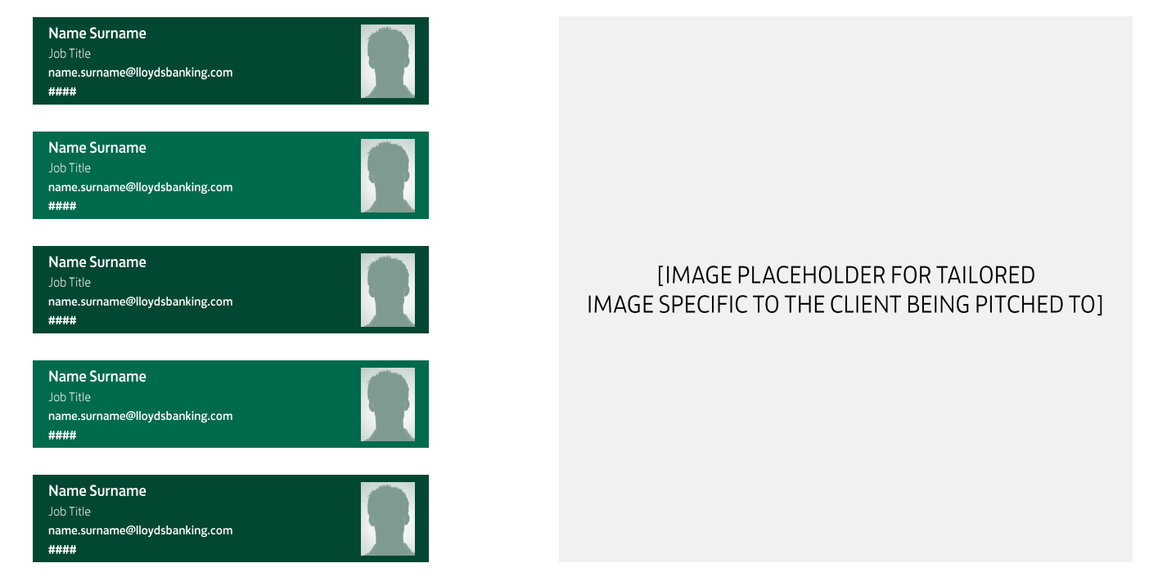

Your Local Team at Lloyds Bank
Dynamic
Notes:
Template Design guidelines - PPT Template - Downloadable File 20231207.pptx (sharepoint.com)
Team page template - Corporate Coverage - 4a. Team Templates 20231109.pdf - All Documents (sharepoint.com)

Slide 9
Understanding your Industry
Predefined

Slide 10
Industry Overview
Dynamic
Key Industry Parameters
Revenue
XXXXX
YY-YY CAGR – XX%
Profit
XXXXX
YY-YY CAGR – XX%
Profit Margins
XXXXX
YY-YY CAGR – XX%
Industry Outlook
bis iur, optas a dit re et magnam latur, que molorem oluptatur. Veriorro etur, il ipsam evellupta coribus etur, optatur, tem quaero consecea endi sum quoditatibus alitae pro int exped eic tem audi dolupta doloreseque voluptatio con corpore rcianditio omnimpe ribusanda aligeni ssiminiae possim verersp erupta dolorio to etur maximpos et aut voluptati ipsanis.
Notes:
IBIS report
Link to websites of similar size companies in the industry to frame outlook.
Any other data source.

Slide 11




Industry Drivers
Dynamic
Key point 1
Key point 2
Key point 3
Key point 4
bis iur, optas a dit re et magnam latur, que molorem oluptatur. Veriorro etur, il ipsam evellupta coribus etur, optatur, tem quaero consecea endi sum quoditatibus alitae pro int exped eic tem audi dolupta doloreseque voluptatio con corpore rcianditio omnimpe ribusanda aligeni ssiminiae possim verersp erupta dolorio to etur maximpos et aut voluptati ipsanis.
Ebis iur, optas a dit re et magnam latur, que molorem oluptatur.
Veriorro etur, il ipsam evellupta coribus etur, optatur, tem quaero consecea endi sum quoditatibus alitae pro int exped eic tem audi dolupta doloreseque. voluptatio con corpore rcianditio omnimpe.
Ebis iur, optas a dit re et magnam latur, que molorem oluptatur. Veriorro etur, il ipsam evellupta coribus etur, optatur, tem quaero consecea endi sum quoditatibus alitae pro int exped eic tem audi dolupta doloreseque voluptatio con corpore rcianditio omnimpe ribusanda aligeni ssiminiae possim verersp erupta dolorio to etur maximpos et aut voluptati ipsanis. ma de.
Ebis iur, optas a dit re et magnam latur, que molorem oluptatur.Veriorro etur, ilipsam evellupta coribus etur, optatur, tem quaero consecea endi sum quoditatibus alitae pro int exped eic tem audi dolupta doloreseque. voluptatio con corpore rcianditio omnimpe ribusanda aligeni ssiminiae.
Notes:
Upload IBIS report

Slide 12
Industry competitive forces
Dynamic
Market Concentration
Entry Barriers
bis iur, optas a dit re et magnam latur, que molorem oluptatur. Veriorro etur, il ipsam evellupta coribus etur, optatur, tem quaero consecea endi sum quoditatibus alitae pro int exped eic tem audi dolupta doloreseque voluptatio con corpore rcianditio omnimpe ribusanda aligeni ssiminiae possim verersp erupta dolorio to etur maximpos et aut voluptati ipsanis.
bis iur, optas a dit re et magnam latur, que molorem oluptatur. Veriorro etur, il ipsam evellupta coribus etur, optatur, tem quaero consecea endi sum quoditatibus alitae pro int exped eic tem audi dolupta doloreseque voluptatio con corpore rcianditio omnimpe ribusanda aligeni ssiminiae possim verersp erupta dolorio to etur maximpos et aut voluptati ipsanis.
Substitutes
Buyer and Supplier Power
bis iur, optas a dit re et magnam latur, que molorem oluptatur. Veriorro etur, il ipsam evellupta coribus etur, optatur, tem quaero consecea endi sum quoditatibus alitae pro int exped eic tem audi dolupta doloreseque voluptatio con corpore rcianditio omnimpe ribusanda aligeni ssiminiae possim verersp erupta dolorio to etur maximpos et aut voluptati ipsanis.
bis iur, optas a dit re et magnam latur, que molorem oluptatur. Veriorro etur, il ipsam evellupta coribus etur, optatur, tem quaero consecea endi sum quoditatibus alitae pro int exped eic tem audi dolupta doloreseque voluptatio con corpore rcianditio omnimpe ribusanda aligeni ssiminiae possim verersp erupta dolorio to etur maximpos et aut voluptati ipsanis.

Slide 13
Understanding your Business
Predefined

Slide 14
Company Overview
Dynamic
Company Overview
Revenue FY XX
XXXXX
YY-YY YoY– XX%
PBT FY XX
XXXXX
YY-YY YoY – XX%
PAT FY XX
XXXXX
YY-YY YoY – XX%
Networth
XXXXX
YY-YY YoY – XX%
Company Vision and Mission
Product and Services
Strategic outlook
Ebis iur, optas a dit re et magnam latur, que molorem oluptatur.
Veriorro etur, il ipsam evelluta coribus etur, optatur, tem quaero.
Consecea endi sum quoditatibus alitae pro int exped eic tem audi dolupta doloreseque voluptatio con corpore rcianditio omnimpe ribusanda aligeni ssiminiae possim verersp erupta dolorio to etur maximpos et aut voluptati ipsanis ma deEpudia velitem porupienet arum inisquis ut molorem dolorupta vid everovi tibus.
Menimus.
Ebis iur, optas a dit re et magnam latur, que molorem oluptatur. Veriorro etur, il ipsam evellupta coribus etur, optatur, tem quaero consecea endi sum quoditatibus alitae pro int exped eic tem audi dolupta doloreseque voluptatio con corpore rcianditio.
Omnimpe ribusanda aligeni ssiminiae possim verersp erupta dolorio to etur maximpos et aut voluptati ipsanis ma deEpudia velitem porupienet arum inisquis ut molorem dolorupta vid everovi tibus.
Ebis iur, optas a dit re et magnam latur, que molorem oluptatur.
Veriorro etur, il ipsam evellupta coribus etur, optatur, tem quaero consecea endi sum quoditatibus alitae pro int exped eic tem audi dolupta doloreseque voluptatio con corpore rcianditio omnimpe ribusanda aligeni ssiminiae possim verersp erupta dolorio to etur
maximpos et aut voluptati ipsanis ma deEpudia velitem porupienet arum inisquis ut molorem dolorupta vid everovi tibus.
Notes:
Annual reports
Websites link for the company.
Full circl

Slide 15
P&L Overview
Dynamic
Revenue and Profit Trends
Revenue Trend
coribus etur, optatur, tem quaero consecea endi sum quoditatibus alitae pro int.
Profit Trend
coribus etur, optatur, tem quaero consecea endi sum quoditatibus alitae pro int.
Notes:
Full circl PDF
Website
3 Annual reports per company

Slide 16
How LBG can support
Predefined

Slide 17
How LBG can support
Dynamic
Point 1
Key point 2
Key point 3
Key point 4
bis iur, optas a dit re et magnam latur, que molorem oluptatur. Veriorro etur, il ipsam evellupta coribus etur, optatur, tem quaero consecea endi sum quoditatibus alitae pro int exped eic tem audi dolupta doloreseque voluptatio con corpore rcianditio omnimpe ribusanda aligeni ssiminiae possim verersp erupta dolorio to etur maximpos et aut voluptati ipsanis.
Ebis iur, optas a dit re et magnam latur, que molorem oluptatur.
Veriorro etur, il ipsam evellupta coribus etur, optatur, tem quaero consecea endi sum quoditatibus alitae pro int exped eic tem audi dolupta doloreseque. voluptatio con corpore rcianditio omnimpe.
Ebis iur, optas a dit re et magnam latur, que molorem oluptatur. Veriorro etur, il ipsam evellupta coribus etur, optatur, tem quaero consecea endi sum quoditatibus alitae pro int exped eic tem audi dolupta doloreseque voluptatio con corpore rcianditio omnimpe ribusanda aligeni ssiminiae possim verersp erupta dolorio to etur maximpos et aut voluptati ipsanis. ma de.
Ebis iur, optas a dit re et magnam latur, que molorem oluptatur.Veriorro etur, ilipsam evellupta coribus etur, optatur, tem quaero consecea endi sum quoditatibus alitae pro int exped eic tem audi dolupta doloreseque. voluptatio con corpore rcianditio omnimpe ribusanda aligeni ssiminiae.

Slide 18
LBG Products
Predefined

Slide 19
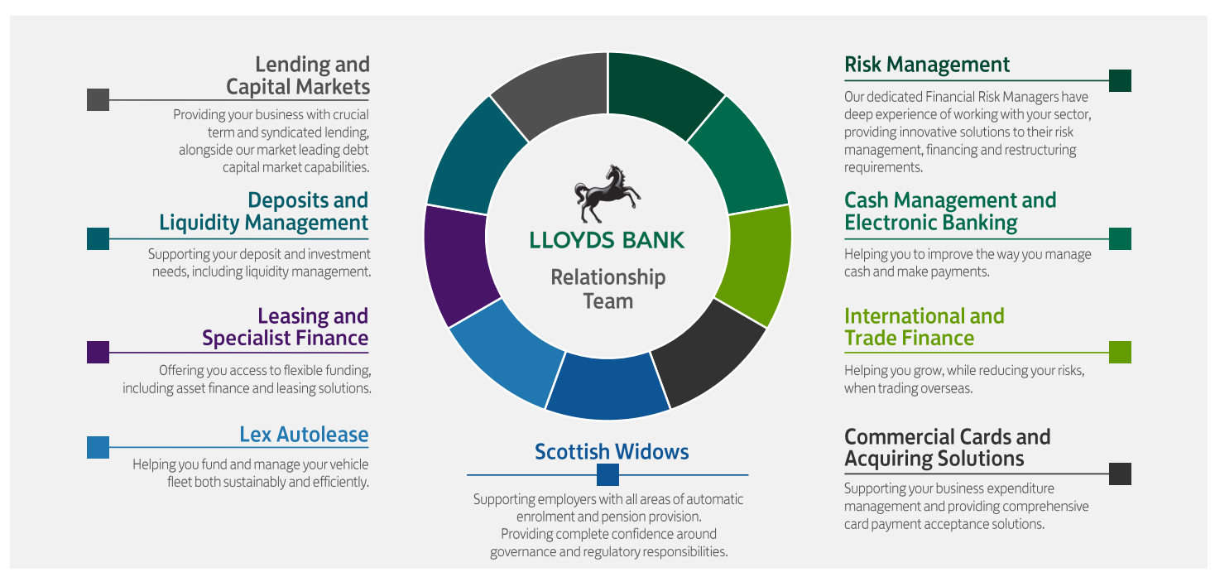
Areas of Specialization
Predefined
Notes:
Source of content -Corporate Coverage - 4d. CIB 20231109.pdf - All Documents (sharepoint.com)

Slide 20
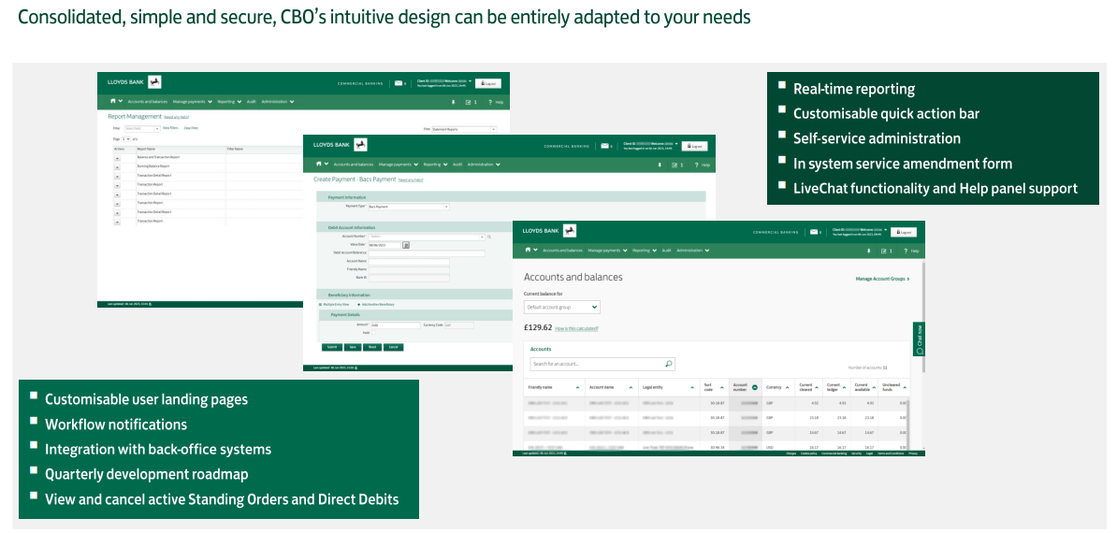
Commercial Banking Online
Predefined
Notes:
Source of content - Corporate Coverage - 05d. CBO 20230621.pdf - All Documents (sharepoint.com)

Slide 21
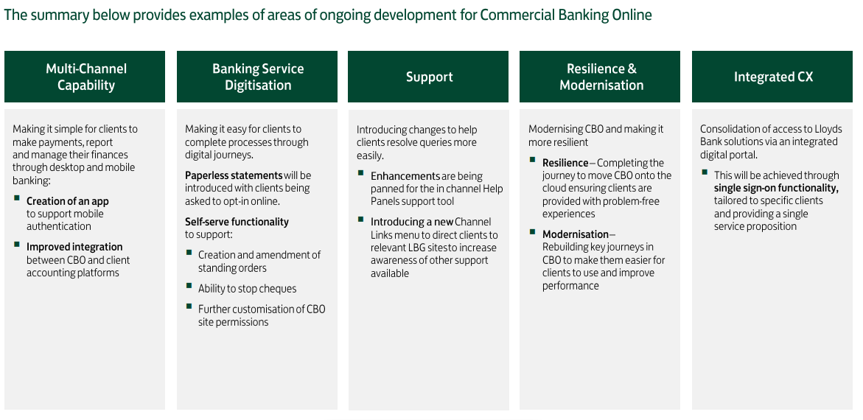
CBO Future Development Roadmap
Predefined
Notes:
Source of content - Corporate Coverage - 05d. CBO 20230621.pdf - All Documents (sharepoint.com)

Slide 22
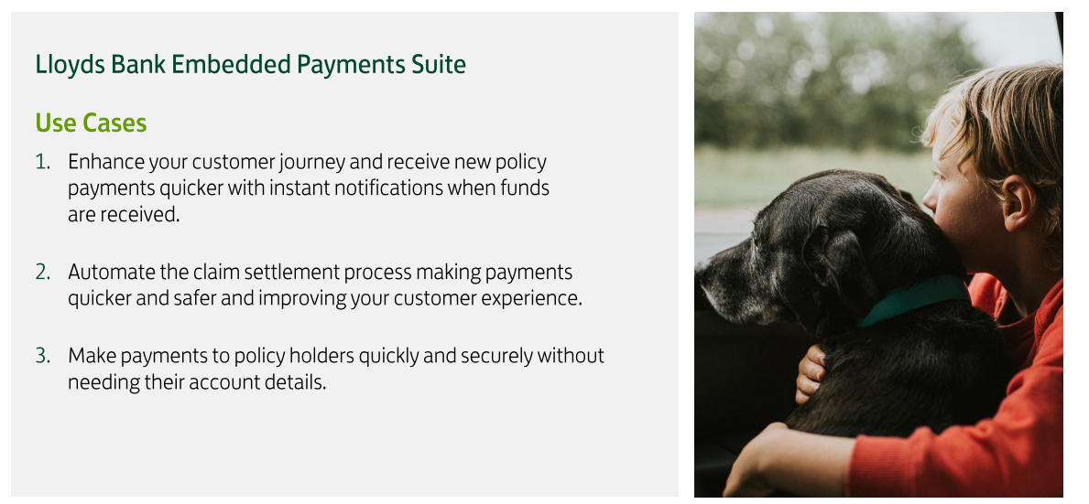
Embedded Payment Insurance
Predefined
Notes:
Source of content - Corporate Coverage - 05ba. Embedded Payments Overview SECTORS 20231127.pdf - All Documents (sharepoint.com)

Slide 23

Embedded Payment Insurance
Predefined
Notes:
Source of content - Corporate Coverage - 05ba. Embedded Payments Overview SECTORS 20231127.pdf - All Documents (sharepoint.com)

Slide 24
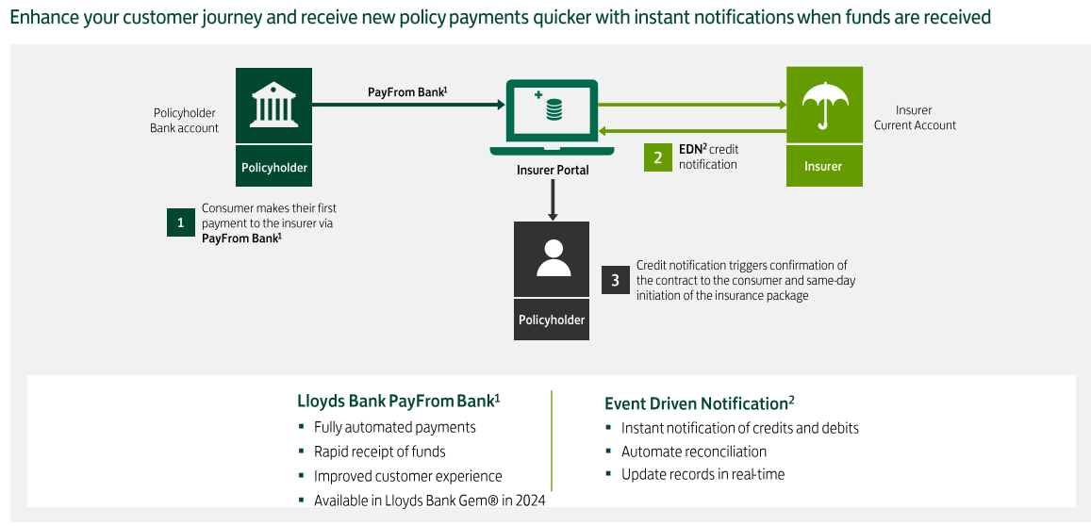
Embedded Payment Insurance – Initiating Insurance Policy
Predefined
Notes:
Source of content - Corporate Coverage - 05ba. Embedded Payments Overview SECTORS 20231127.pdf - All Documents (sharepoint.com)

Slide 25
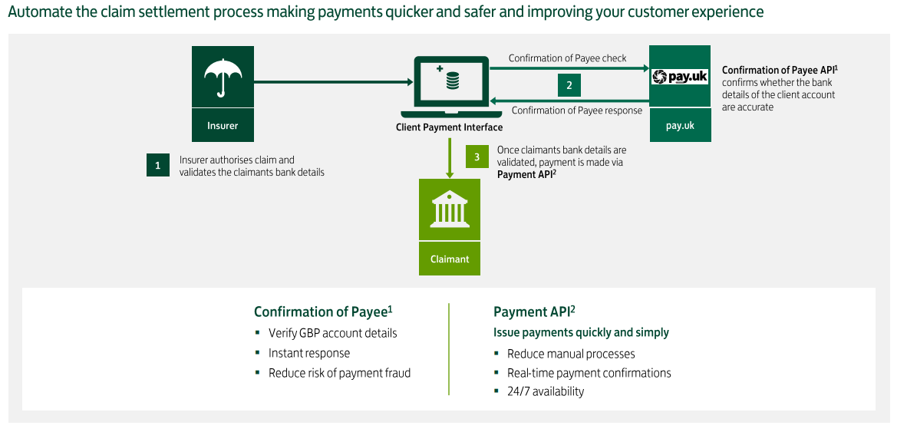
Embedded Payment Insurance – Automated Claim settlement
Predefined
Notes:
Source of content - Corporate Coverage - 05ba. Embedded Payments Overview SECTORS 20231127.pdf - All Documents (sharepoint.com)

Slide 26
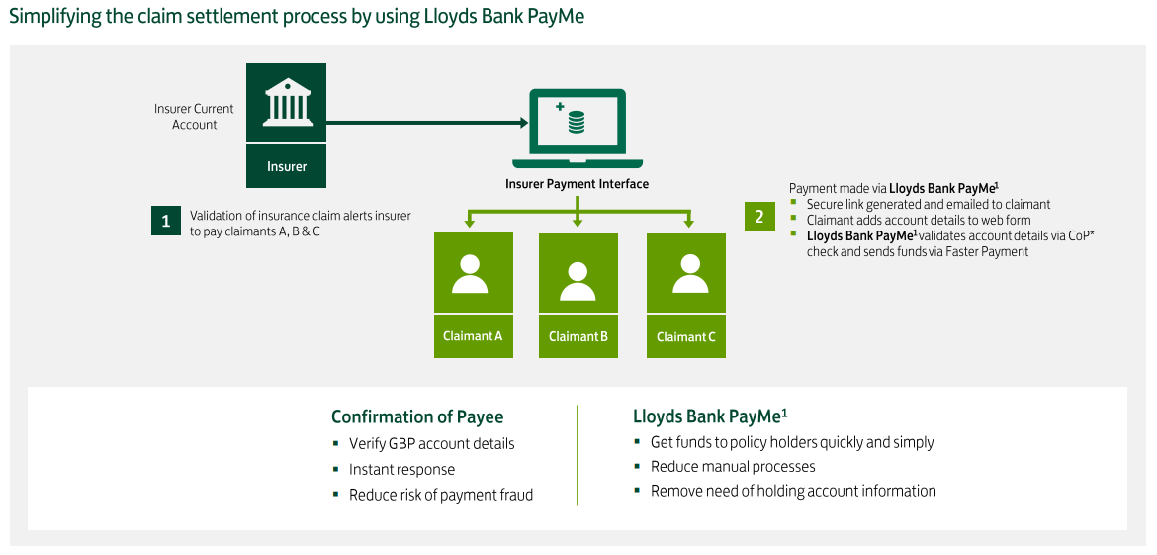
Embedded Payment Insurance – Claim settlement
Predefined
Notes:
Source of content - Corporate Coverage - 05ba. Embedded Payments Overview SECTORS 20231127.pdf - All Documents (sharepoint.com)

Slide 27
ESG Financing
Predefined

Slide 28
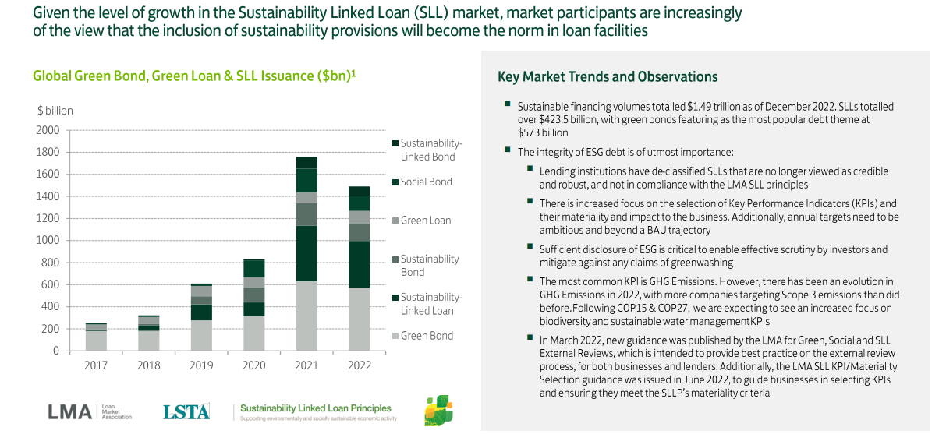
The ESG Financing Market
Predefined
Notes:
Source - Corporate Coverage - 09a. ESG Finance, Products, and Propositions 20231012.pdf - All Documents (sharepoint.com)

Slide 29
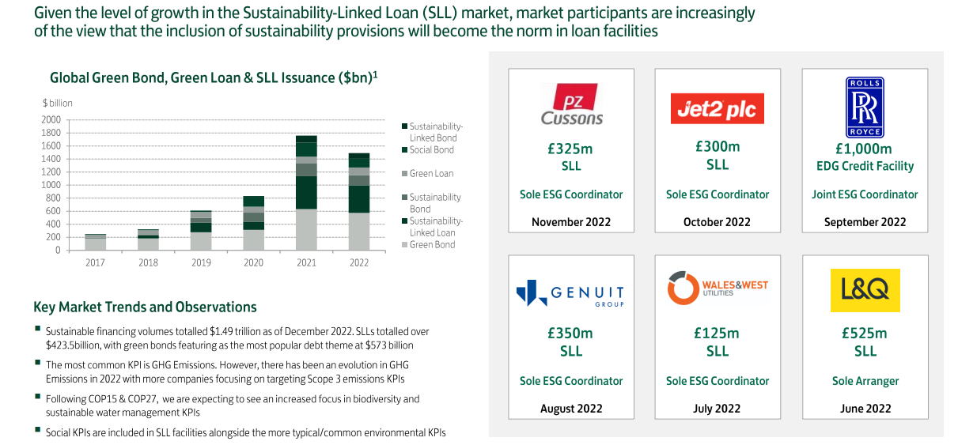
The ESG Financing Market & Recent Lloyds Bank Transactions
Predefined
Notes:
Source - Corporate Coverage - 09a. ESG Finance, Products, and Propositions 20231012.pdf - All Documents (sharepoint.com)

Slide 30
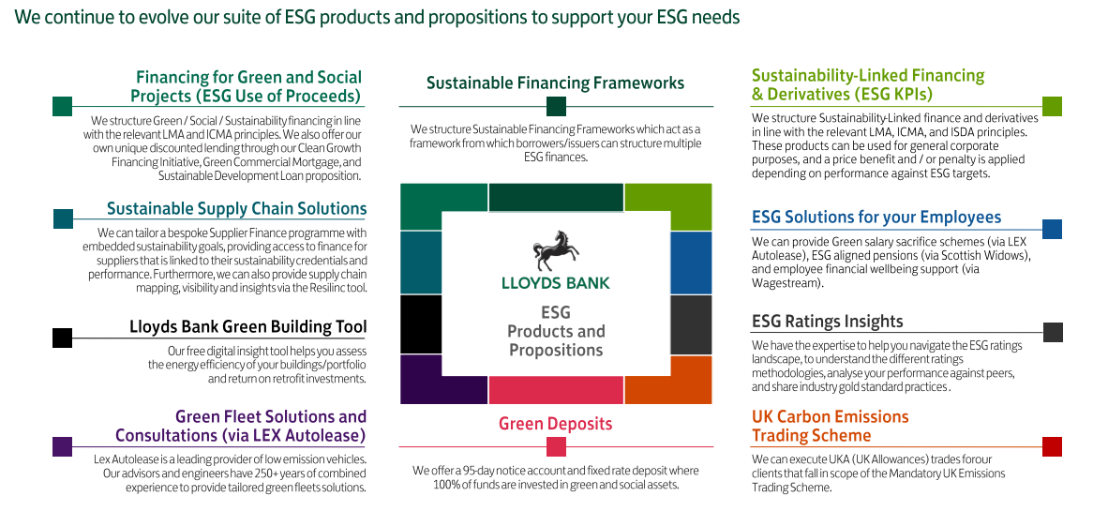
Lloyd Bank’s ESG solutions
Predefined
Notes:
Source - Corporate Coverage - 09a. ESG Finance, Products, and Propositions 20231012.pdf - All Documents (sharepoint.com)

Slide 31
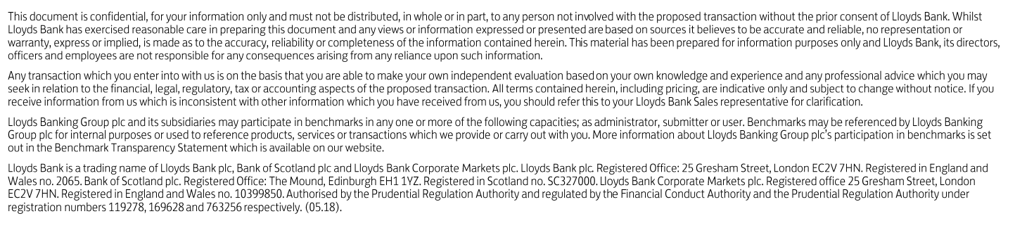

Important Information
Predefined
Notes:
Source - Corporate Coverage - 02a. Lloyds Bank Disclaimers 20231109.pdf - All Documents (sharepoint.com)

Slide 32
Predefined

